Slide 2
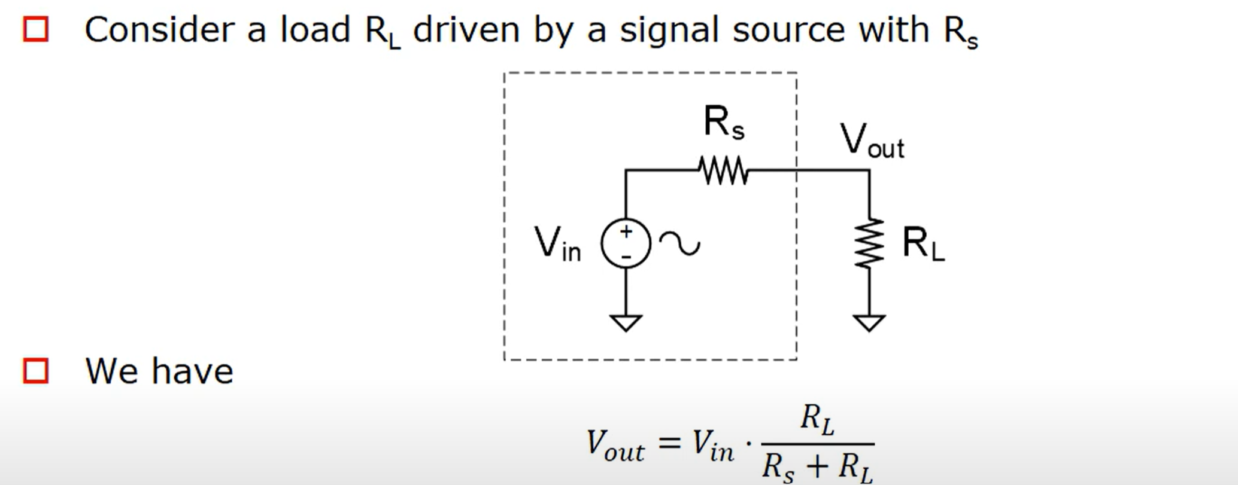
Basic of Restive Load

Slide 3
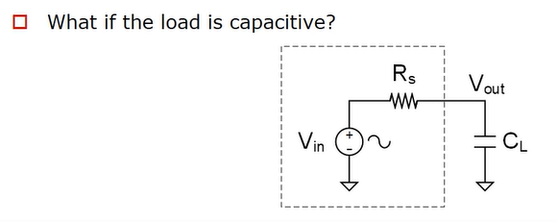
Basic of Capacitive Load

Slide 4
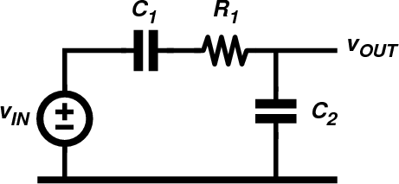

Circuit analysis with phasors and complex impedances
What is the amplitude and phase of the sinusoidal output voltage for C1=10nF, C2=20nF, R1=10kΩ and v_{IN} a sinewave with frequency 1kHz and amplitude 1V?
d ²v
⎛
C ⎞ dv
dv
R C
⎜
⎟
OUT
dt ²
+ 1+
2 OUT
=
IN
dt
1 2
⎜ _{C} ⎟
dt
⎝ 1 ⎠

Slide 5
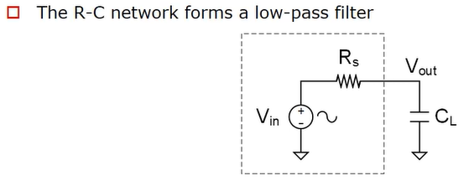
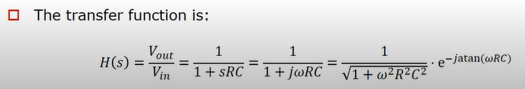
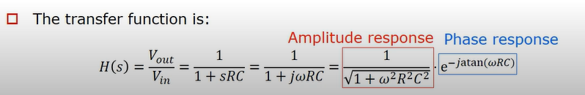

Slide 6
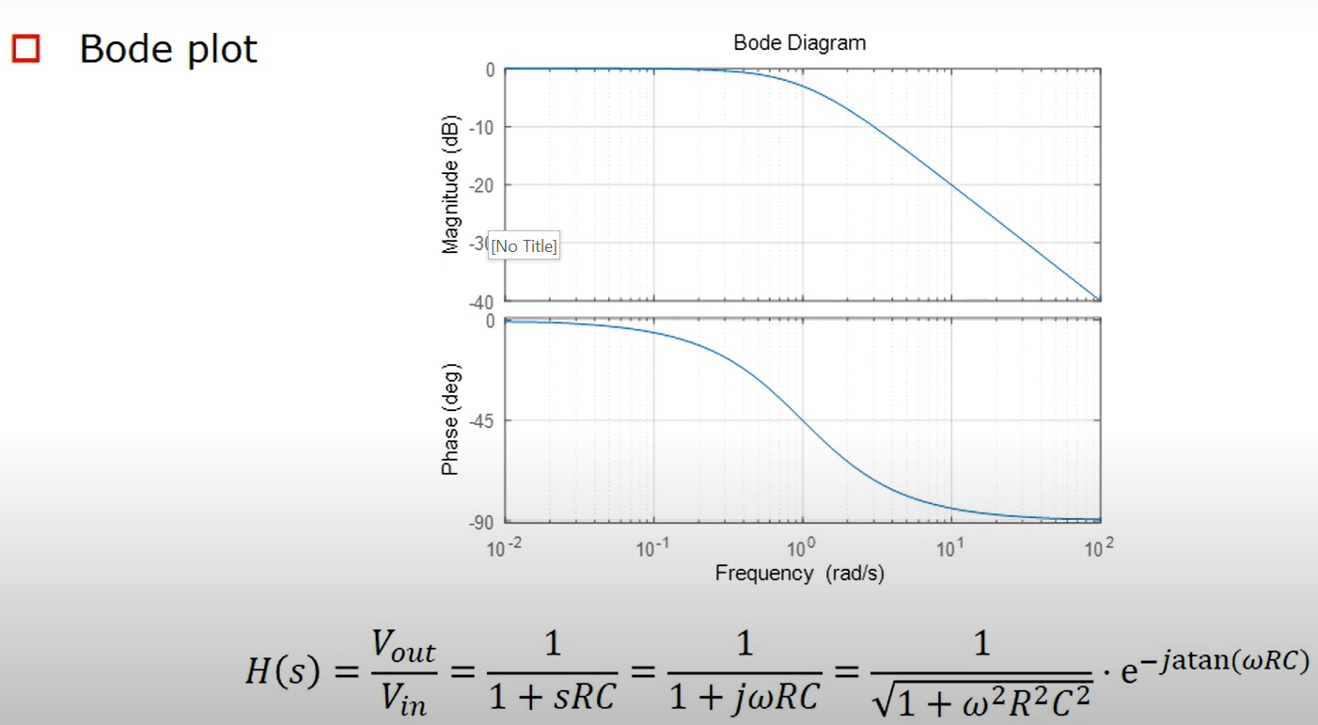
Bode Plot

Slide 7
Circuit analysis with phasors and complex impedances
Assume v_{IN} is sinusoidal and use phasors and impedances
1
Z₁ = R₁ +
jωC
1
1
Z =
2
jωC
2
Indeed, we can just solve this network in the phasor domain. It behaves as a voltage divider, made from impedances. We first write the impedance of Z1 and Z2

Slide 8
Circuit analysis with phasors and complex impedances
Z₂
V = V
IN _{Z}
OUT
+ Z C₁
1
2
1
Using the expressions for Z1 and Z2, we can now easily write the relationship between input phasor (input voltage) and output phasor (output voltage) since this circuit behaves as a voltage divider. The resulting equation is called the transfer function of the circuit (from input to output).
The relationship between input phasor and output phasor is easily found. It is just a complex number. But this complex number depends on the frequency.
= V ⋅
⋅
IN
C + C
C C
1
2
1+ jω ¹ ² R₁
C₁ + C₂
V = V ⋅ (A(ω) ⋅ e ^{jφ (ω )} )
Only one complex number!
OUT
IN

Slide 9
Circuit analysis with phasors and complex impedances
What is the amplitude and phase of the output voltage for C1=10nF, C2=20nF, R1=10kΩ and v_{IN} a sinewave with frequency 1kHz and amplitude 1V?
V = V_{IN} ⋅ (0.2836 − j 0.1188) = V_{IN}
_{0.3075e}− j 0.3967
OUT
𝑣_{𝐼𝑁} = 𝐴 sin( 2𝜋1000𝑡)
𝑣_{0𝑈𝑇} = 𝐴 ⋅ 0.3075 sin( 2𝜋1000𝑡 − 0.3967)
If we plug-in a certain frequency in the expression, we get a complex number that gives the relationship between input and output phasor. We would like to understand the behavior of this circuit for various frequencies.
Output is a sinewave with amplitude of 308mV and initial phase of -0.397 rad (= -22.73 degrees.)

Slide 10
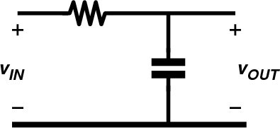
RC low-pass filter
How does this circuit behave for different frequencies?
A simple example of a transfer function is shown on this slide. It is a low pass filter for reasons that will soon become clear.
The transfer function is easily derived. This is indeed a complex number that depends on frequency. By multiplying numerator and denominator by jwC, we obtain a simplified expression with a 1 in the numerator and “1+” in the denominator.
Notice that we also have the product of R and C in that expression, and the units of RC are seconds!
1
^{𝑣}0𝑈𝑇 ₌
𝑍_{𝐶}
j𝜔𝐶
1
=
=
^{𝑣}𝐼𝑁
𝑅 + 𝑍_{𝐶}
_{𝑅 +} 1
1 + j𝜔𝑅𝐶
j𝜔𝐶
𝑟𝑎𝑑
𝜔 ⇒
𝑠
𝑉 𝐶
𝑅𝐶 ⇒ Ω𝐹 = = 𝑠
𝐴 𝑉

Slide 11
RC low-pass filter (2)
How does this circuit behave for different frequencies?
We substitute the expression RC by the time-constant tau, with units in seconds.
Likewise, 1/RC is substituted by the angular frequency omega_c with units
radians/seconds. This new variable omega_C will be called the ‘corner frequency’ of the filter. We can also re-write the expression using frequency in Hz (rather than rad/s).
Note: we will encounter the time constant tau again when we investigate the timedomain behavior of RC circuits.
^{𝑣}0𝑈𝑇 ₌
1
1
1
1
=
=
=
^{𝑣}𝐼𝑁
1 + j𝜔𝑅𝐶
1 + j𝜔𝜏
1 + j ^{𝜔}
𝜔_{𝐶}
1 + j ^{𝑓}
𝑓_{𝐶}
1 𝑟𝑎𝑑
𝜔_{𝐶}
𝑓 = =
1
𝜏 = 𝑅𝐶 𝑠
𝜔 =
𝐻𝑧
𝐶
𝑅𝐶
𝑠
𝐶
2𝜋 2𝜋𝑅𝐶

Slide 12
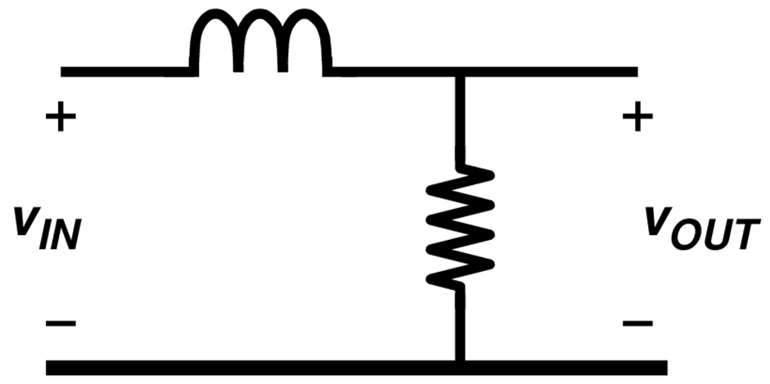
RL low-pass filter
How does this circuit behave for different frequencies?
^{𝑣}0𝑈𝑇 ₌
𝑅
𝑅
1
=
=
^{𝑣}𝐼𝑁
𝑅 + 𝑍_{𝐿}
𝑅 + j𝜔𝐿
1 + j𝜔 ^{𝐿}
𝑅
𝑟𝑎𝑑
𝜔 ⇒
𝐿/𝑅 ⇒ 𝐻/Ω = 𝑠
𝑠

Slide 13
RL low-pass filter (2)
How does this circuit behave for different frequencies?
^{𝑣}0𝑈𝑇 ₌
1
1
1
=
=
^{𝑣}𝐼𝑁
1 + j𝜔 ^{𝐿}
1 + j ^{𝜔}
1 + j ^{𝑓}
𝑅
𝜔_{𝐶}
𝑓_{𝐶}
𝐿
𝜏 =
𝑅 𝑟𝑎𝑑
𝜔 =
𝜔_{𝐶} 𝑅
𝑓 = =
𝑠
𝐶
𝐻𝑧
𝑅
𝐿
𝑠
𝐶
2𝜋 2𝜋𝐿

Slide 14
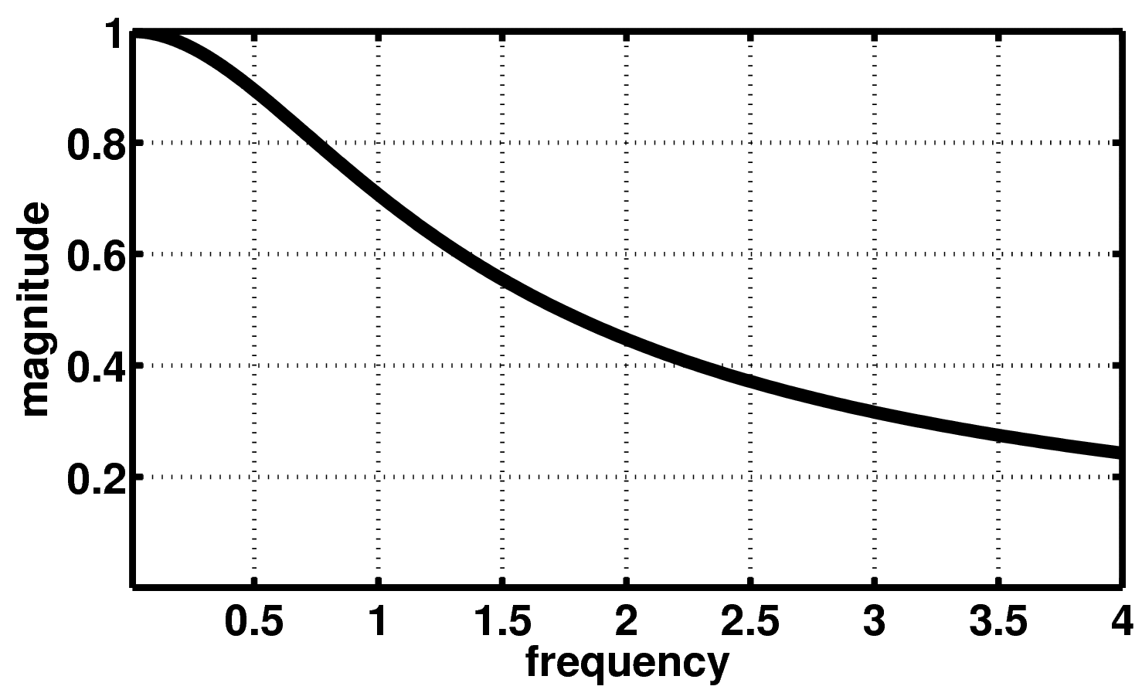
low-pass filter: magnitude
H( jω) = ¹
1
1+ (ω / ω )
f = f_{C} ⇒
H( jω) =
= 0.707
2
2
C
Normalized frequency: f/fc

Slide 15
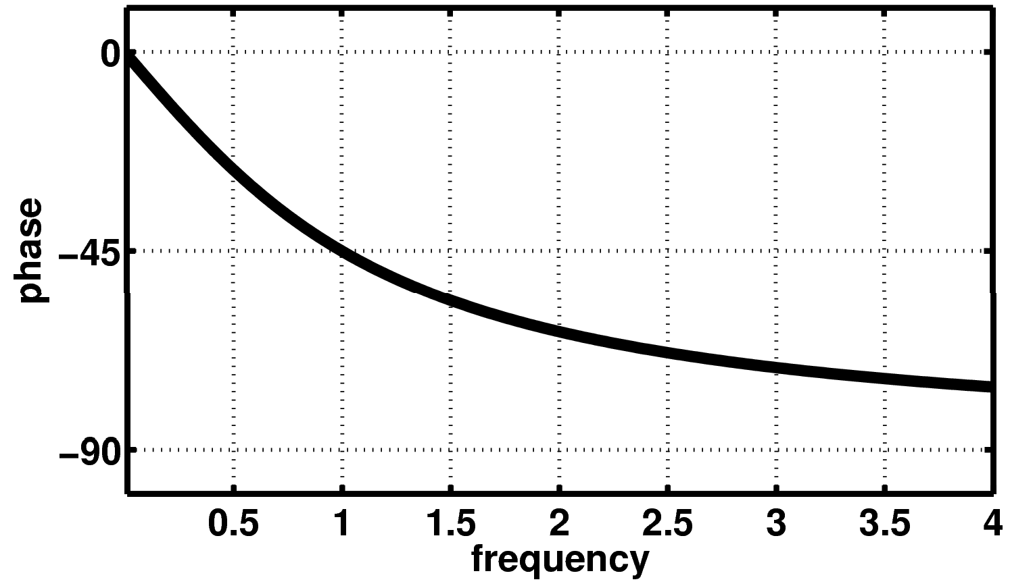
low-pass filter: phase
⎛ ω ⎞
∠H( jω) = 0 − arctan⎜ _{ω} ⎟
f = f_{C} ⇒ ∠H( jω) = −π / 4
⎝ C ⎠
Normalized frequency: f/fc
(

Slide 16
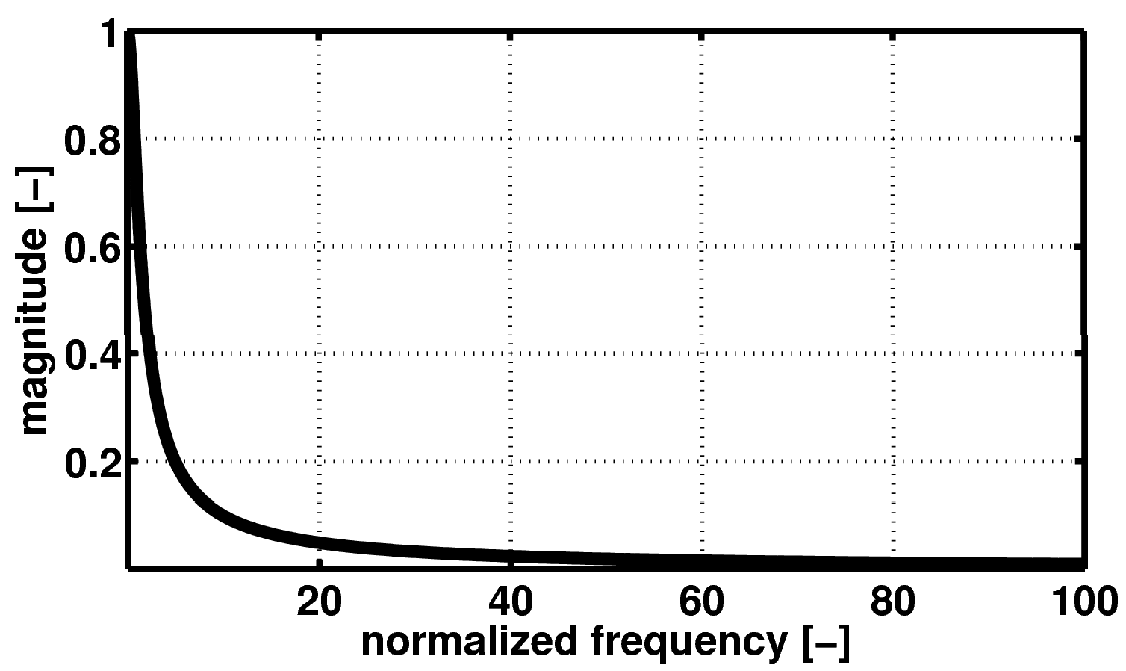
Low-pass filter: magnitude
f/fc

Slide 17
log (10^{x} ) = x
Logarithms
10
log (10^{−x} )= log
10 10
⎛
⎜
^{1 ⎞} = −x
⎟
10
x
⎝ ⎠
log (A )= B log (A)
B
10 10

Slide 18
Benefit of logarithms
1 | ➔ 0
10 | ➔ 1 |  | 0.1 | ➔ - 1
100 | ➔ 2 |  | 0.01 | ➔ - 2
1000 | ➔ 3 |  | 0.001 | ➔ - 3
10000 | ➔ 4 |  | 0.0001 | ➔ - 4
100000 | ➔ 5 |  | 0.00001 | ➔ - 5

Slide 19
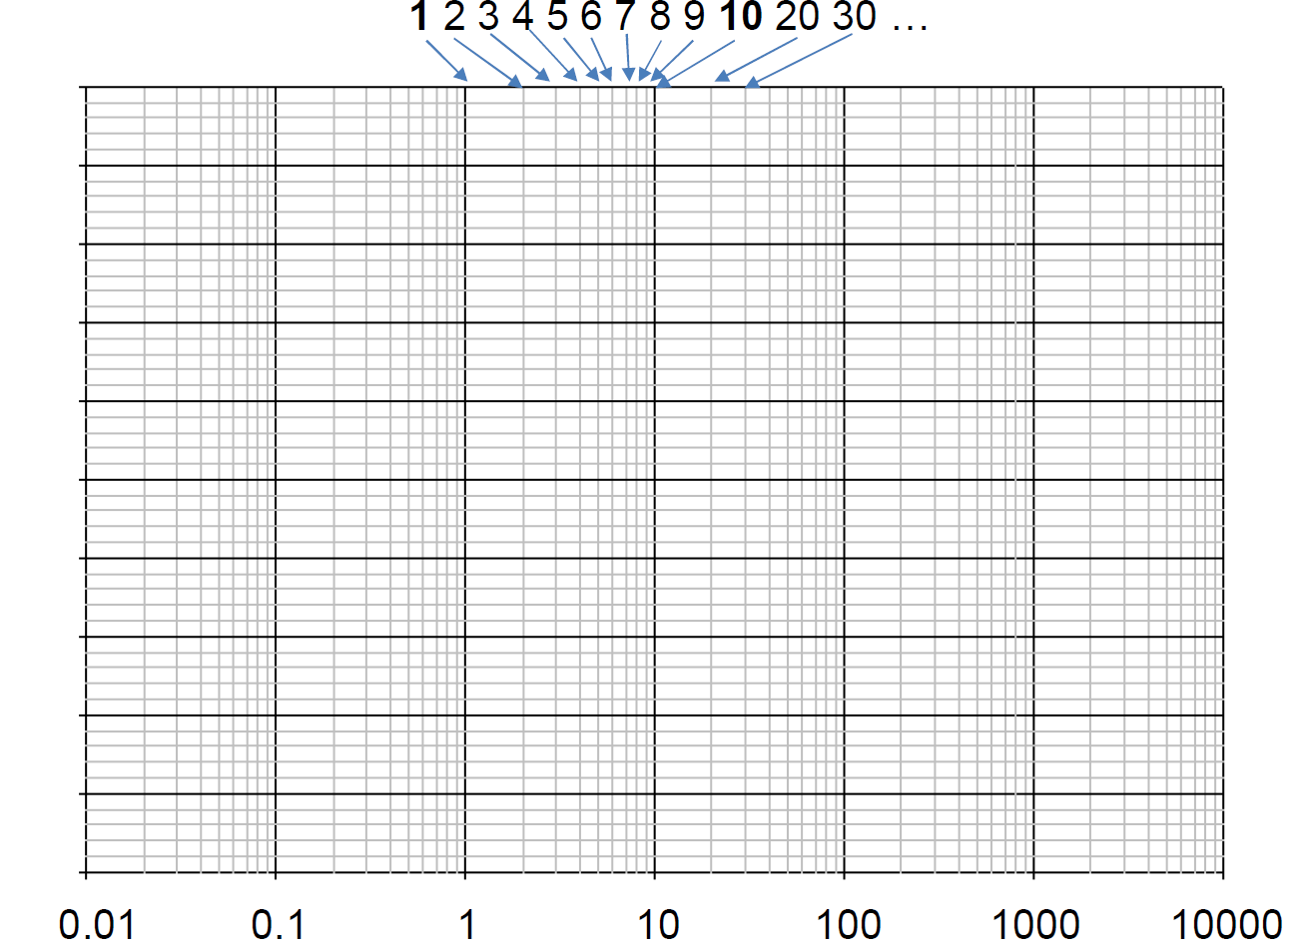
Semilog paper

Slide 20

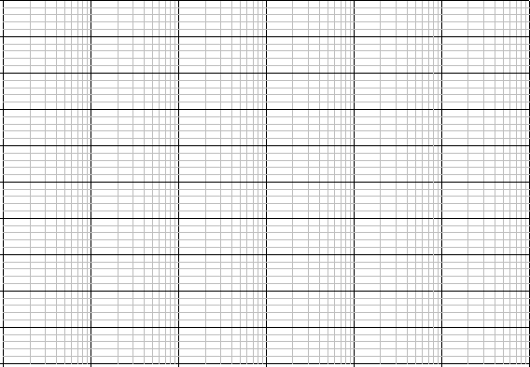
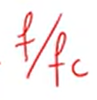
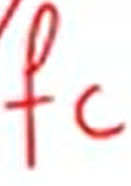
Semilog paper
0.01
0.1
1
10
100
1000
10000

Slide 21
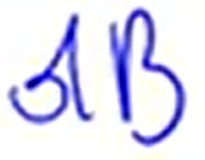
Bell and deciBell
^{⎛ P}OUT ⎞
Bell = log
⎜ ⎟
⎝ IN ⎠
10
P
^{⎛ P}OUT ⎞
dB = 10log
⎜ ⎟
⎝ IN ⎠
10
P
_{⎛V} 2
/ R
⎞
= 10log
⎜
OUT OUT
⎟
10
⎜
⎟
⎝ ^{V}IN^{2 / R}IN ⎠
^{⎛V}OUT ⎞
= 20log
⎜ ⎟
⎝ IN ⎠
10
If R_{OUT} = R_{IN}
V

Slide 22
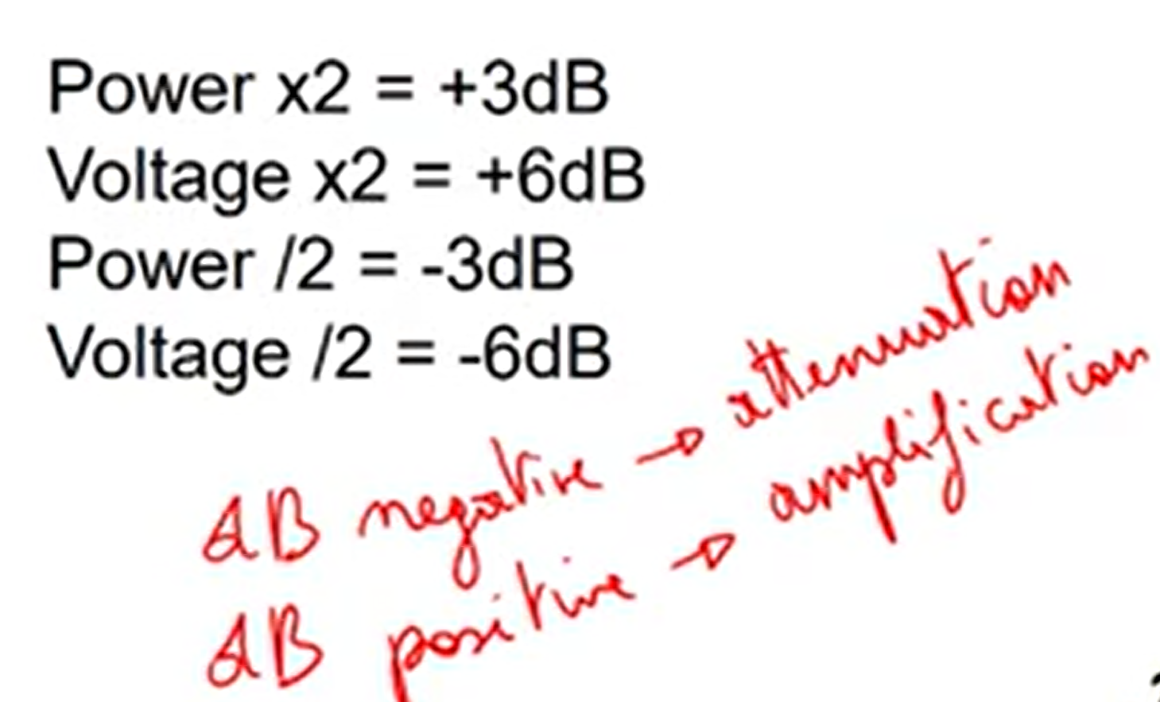
deciBell
(H( jω) )
H( jω)
^{H}dB
H = 20log
dB
10
1
10
0.1
100
0.01
2
4
0.5
2 = 1.414
1 / 2 = 0.707
0dB
+20dB
-20dB
+40dB
-40dB
+6dB
+12dB
-6dB
+3dB
-3dB
Power x2 = +3dB Voltage x2 = +6dB Power /2 = -3dB Voltage /2 = -6dB

Slide 23
dB and dBV
^{𝑉}0𝑈𝑇
𝐻 =
𝐻
= 20 ∙ 𝑙𝑜𝑔 𝐻
𝑑𝐵
10
^{𝑉}𝐼𝑁
^{𝑃}0𝑈𝑇
𝐻 =
𝐻
= 10 ∙ 𝑙𝑜𝑔 𝐻
𝑑𝐵
10
^{𝑃}𝐼𝑁
𝑉_{𝑑𝐵𝑉} = 20 ∙ 𝑙𝑜𝑔₁₀
^{𝑉}𝑅𝑀𝑆

Slide 24
Low-pass filter
( ( ) )
H( jω) = ¹ ⇒ H
= −10log
1+ ω / ω
2
1+ (ω / ω )
2
dB
C
C
f << f_{C} ⇒ H ≈ 1⇒ H_{dB} = 0dB
f = f_{C} ⇒ H = 0.707 ⇒ H_{dB} f >> f_{C} ⇒ H ≈ f_{C} / f ⇒ H_{dB}
= −3dB
= 20log(f_{C} ) − 20log(f )
Sinusoidal signal at input =sinusoidal signal at the output
The frequency is same
The waveform is same
But there is change in Magnitude and phase
₌ ω_{c}
f
C
2π

Slide 25
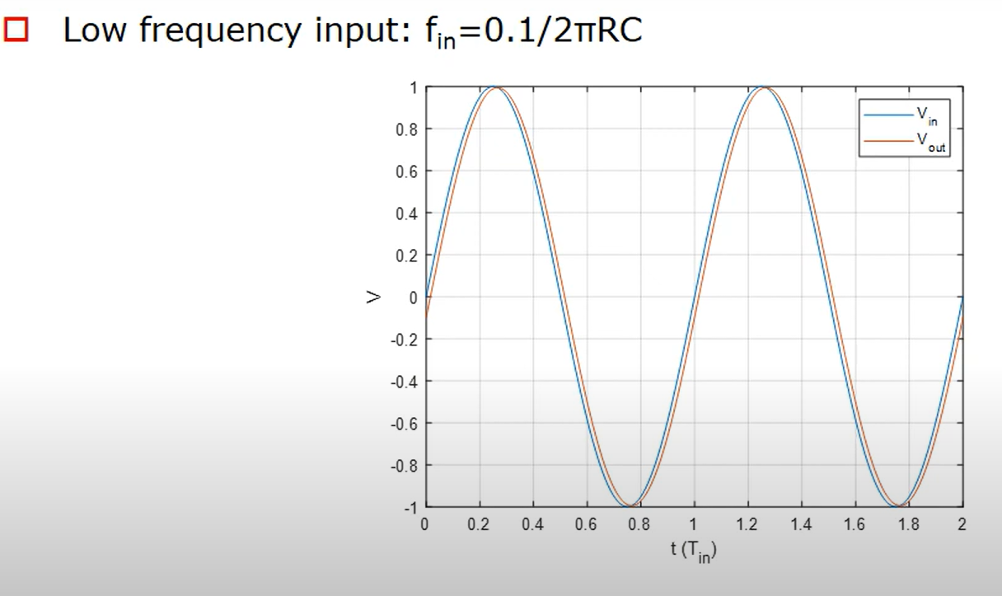
Low Frequency Response

Slide 26
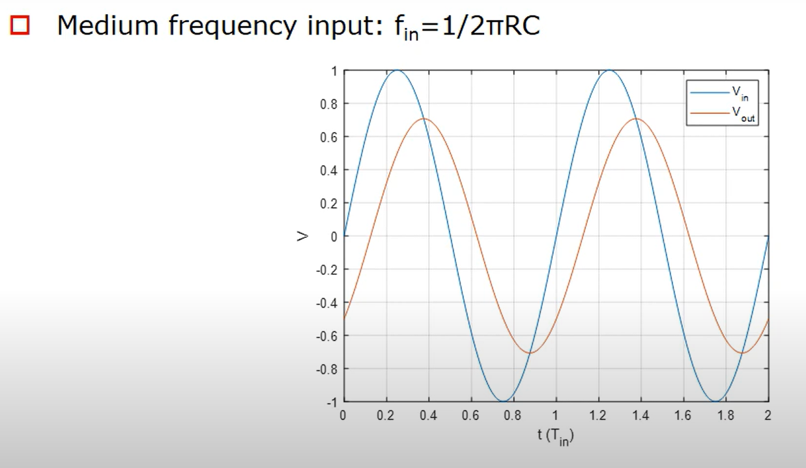
Medium Frequency

Slide 27
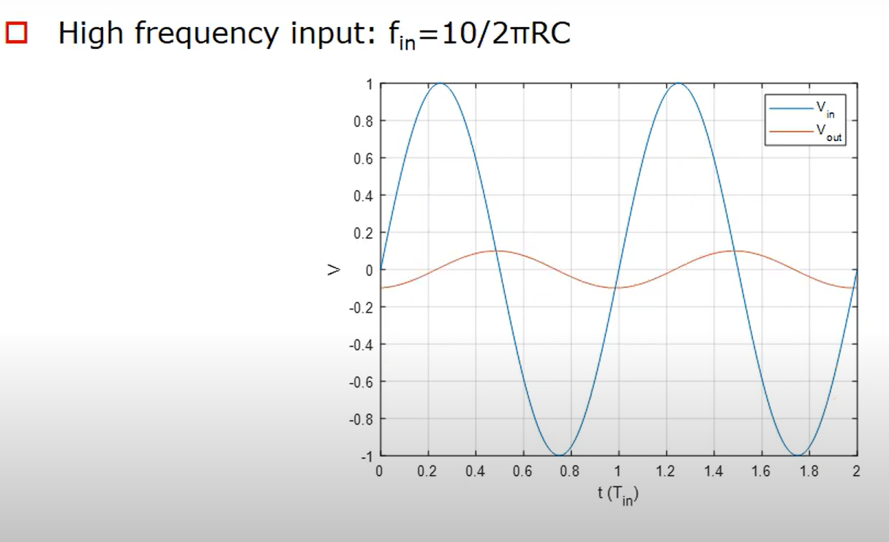
High Frequency

Slide 28
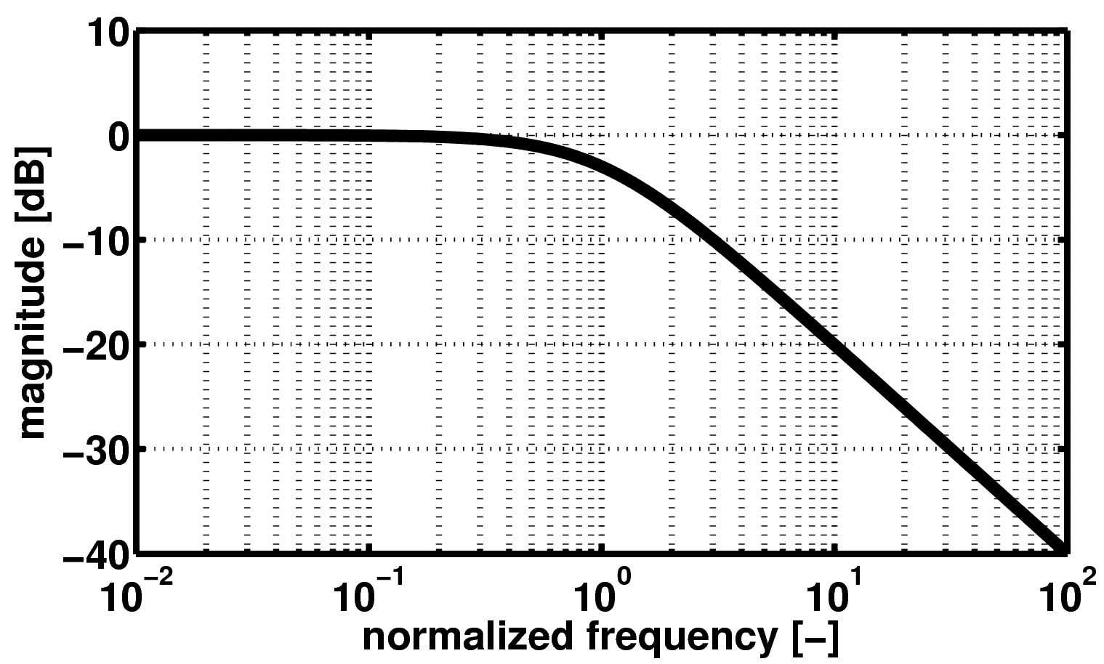
Bode plot - magnitude
0dB
-3dB
-20dB/dec or
-6dB/oct
f/fc

Slide 29
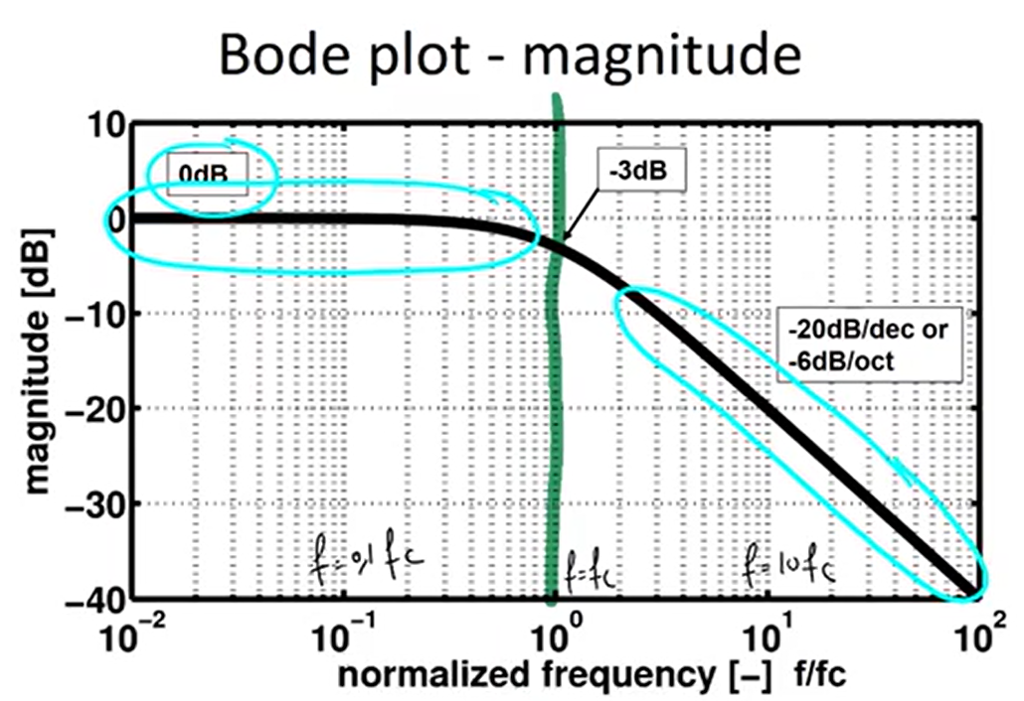
If we increase the frequency by 10, so we multiply the
Frequency by 10, the attenuation increases with 20dB
if the frequency increases by a factor 10

Slide 30
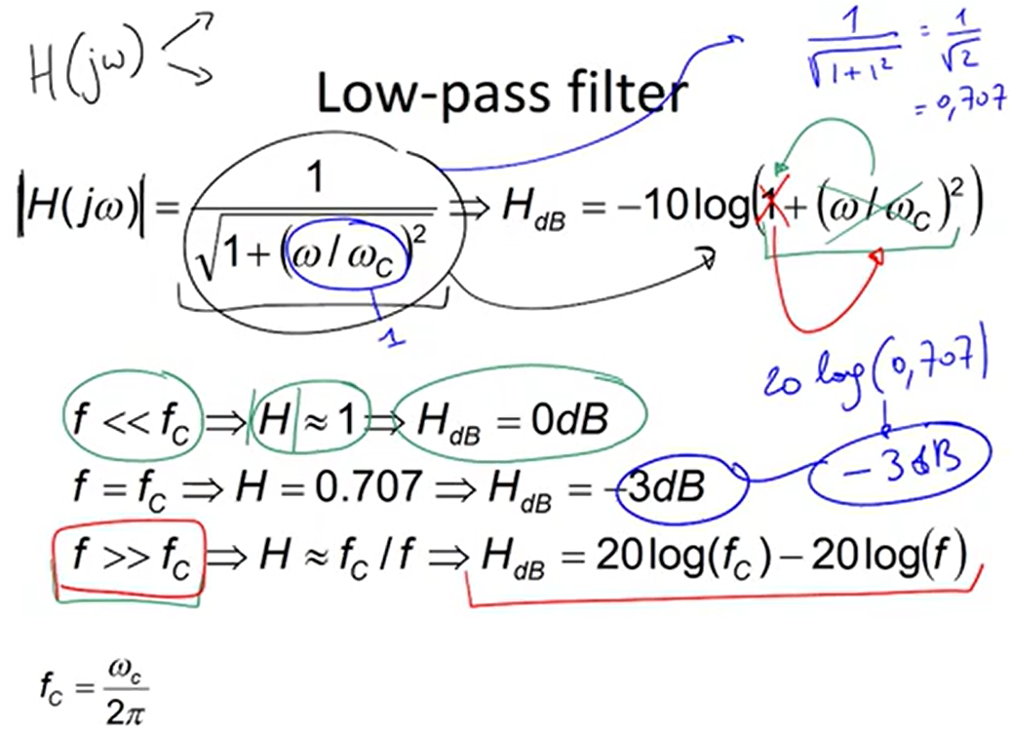

Slide 31
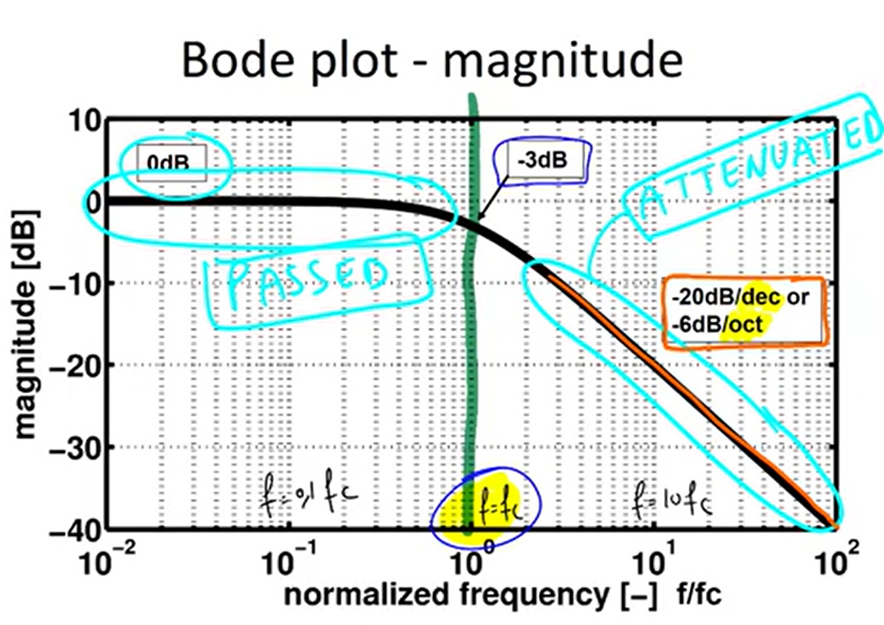

Slide 32
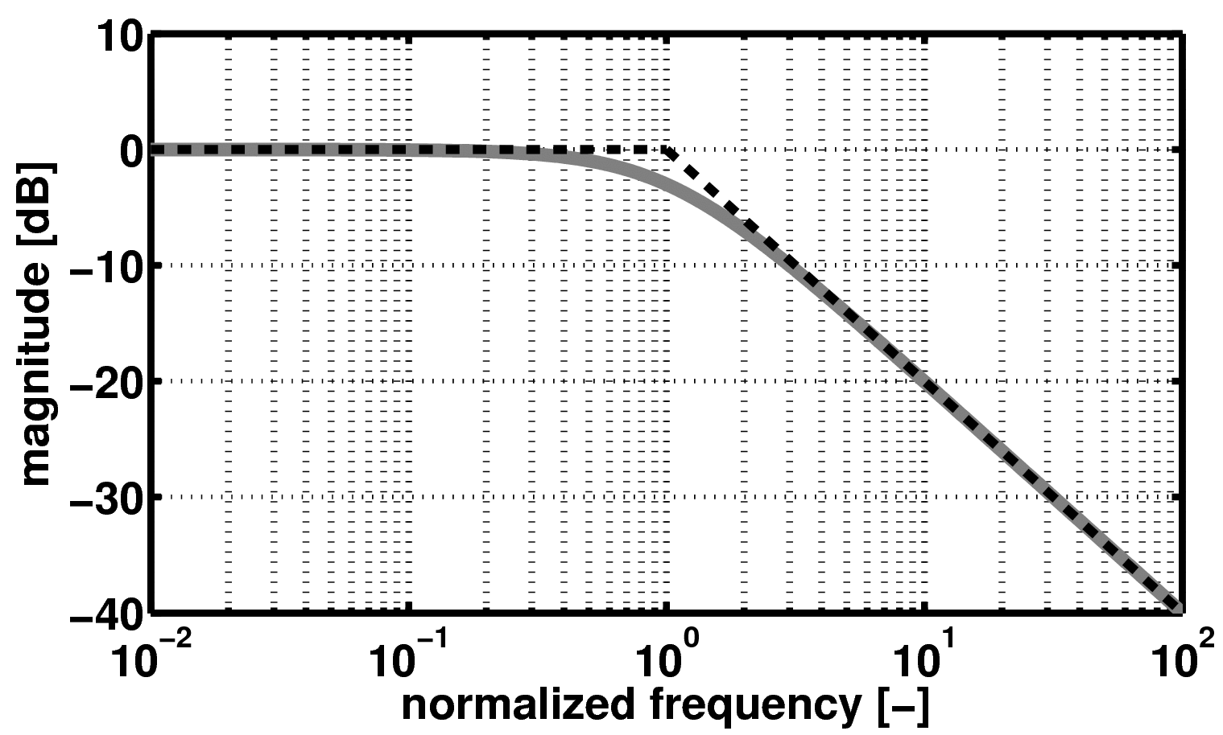
Bode plot – magnitude - asymptotic
Asymptotic approximation
f/fc

Slide 33
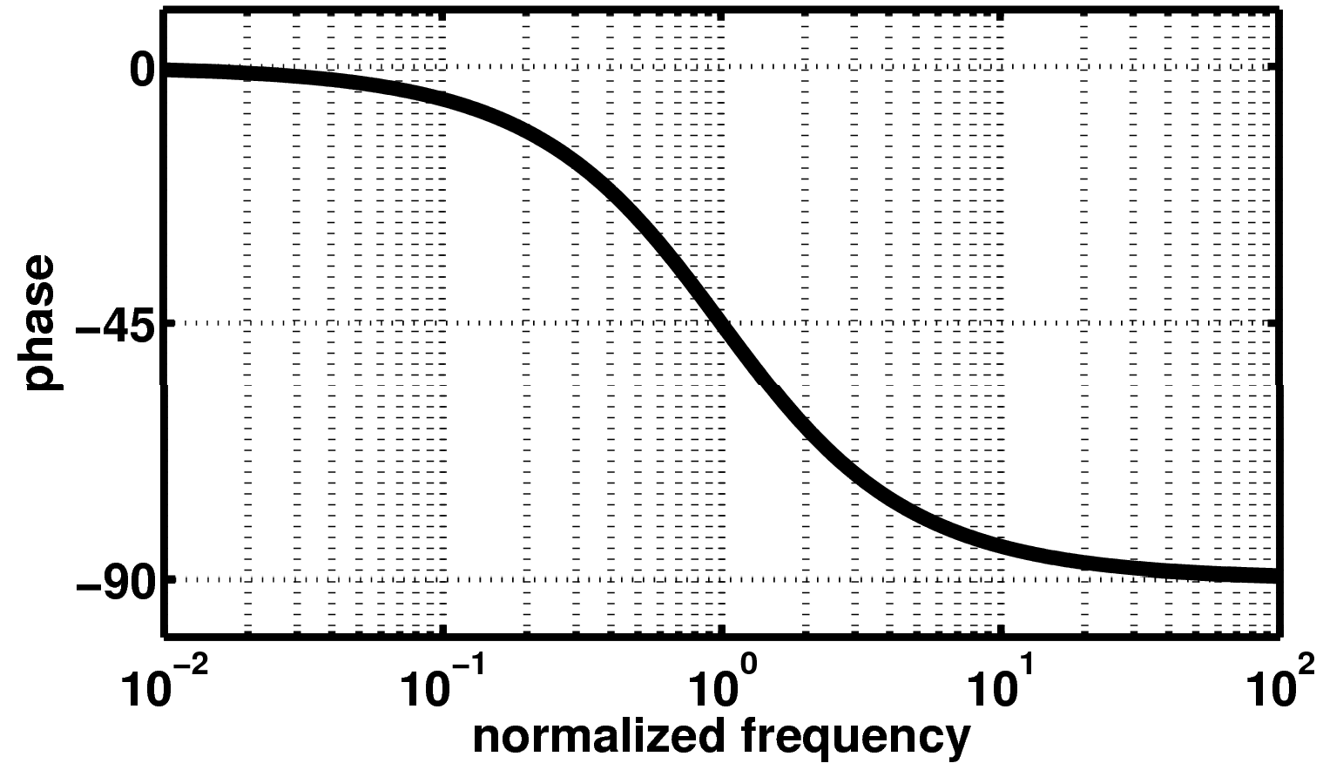
Bode plot - phase

Slide 34
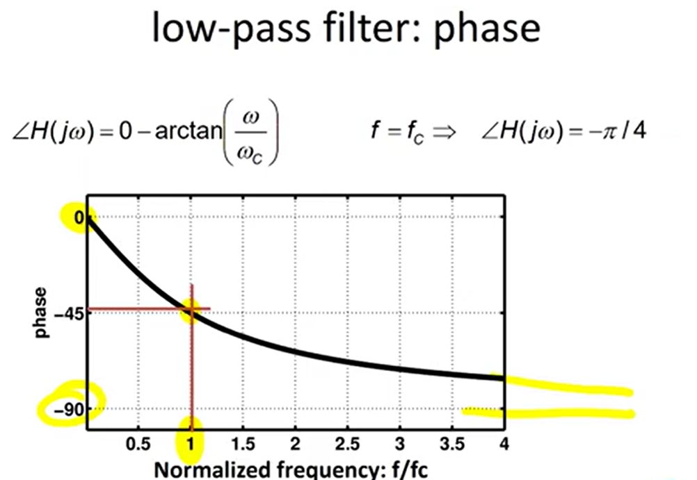

Slide 35
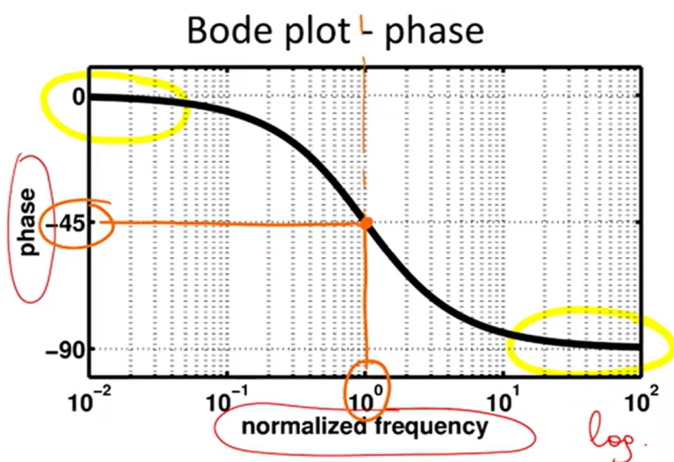

Slide 36
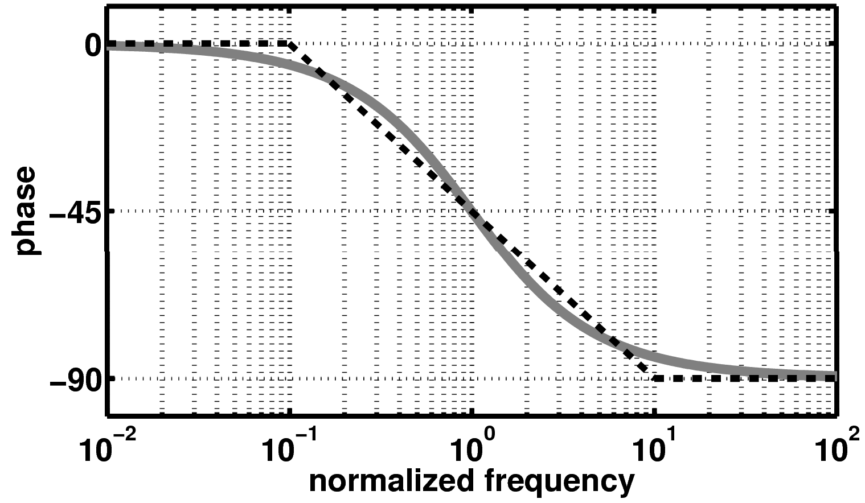
Bode plot – phase - asymptotic
Asymptotic approximation
Asymptotic approximation

Slide 37
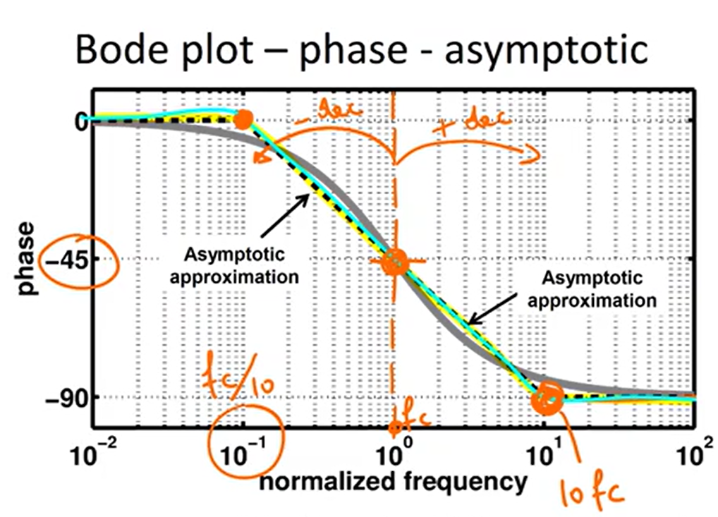

Slide 38
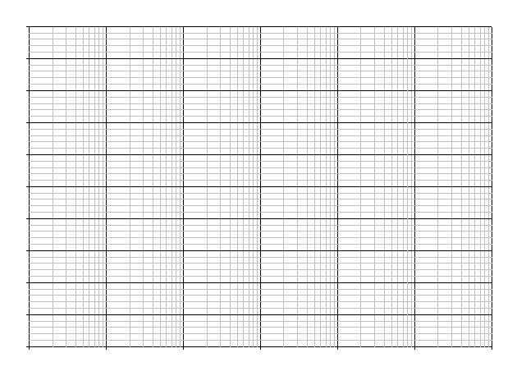
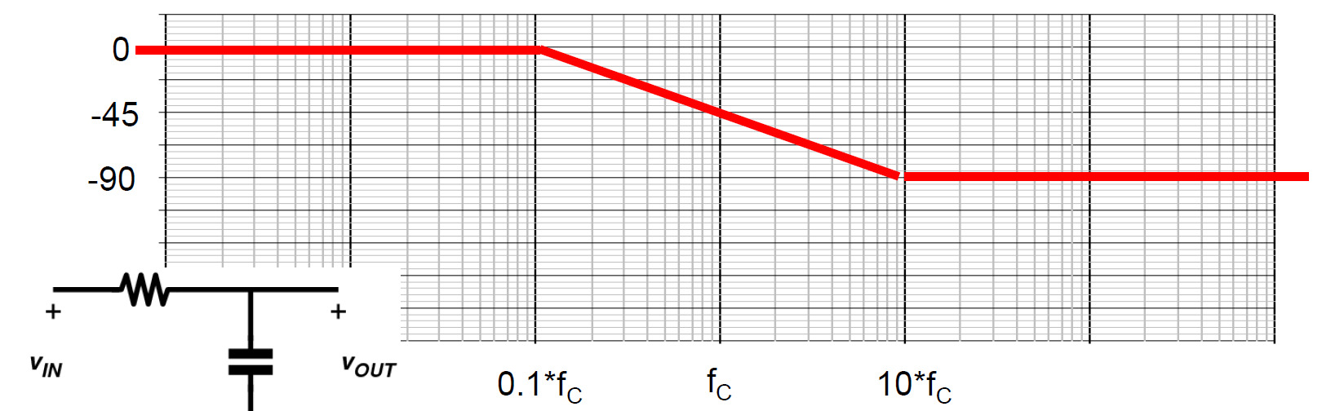
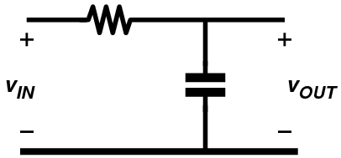
₌ ω_{c}
1
f
=
Low-pass filter
C
2π 2πRC
H( jω) =
1
+20dB
0dB
-20dB
-40dB
1+ j ^{ω}
ω_{C}
-3dB frequency or corner frequency
-60dB
0
-45
-90
0.1*f_{C}
f_{C}
10*f_{C}

Slide 39
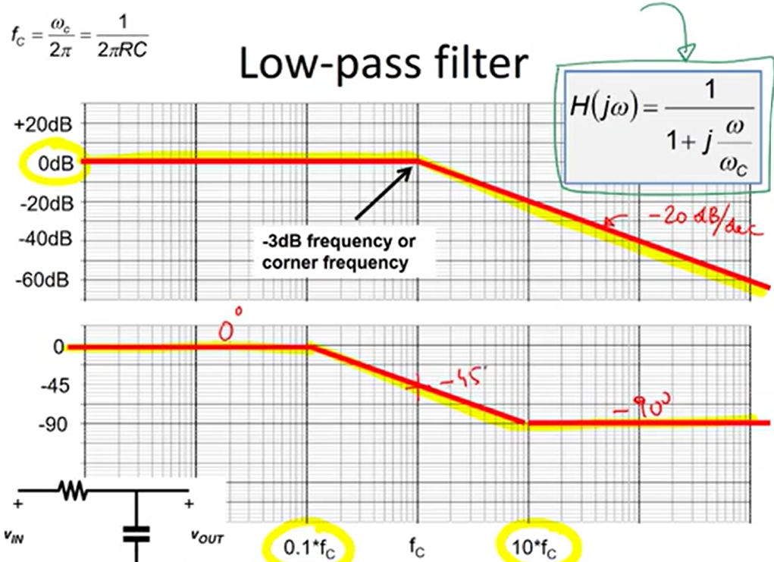

Slide 40
Bode-plot vs. time
+20dB
0dB
-20dB
-40dB
-60dB
0
-45
-90
10Hz
100Hz
1kHz
10kHz
100kHz

Slide 41
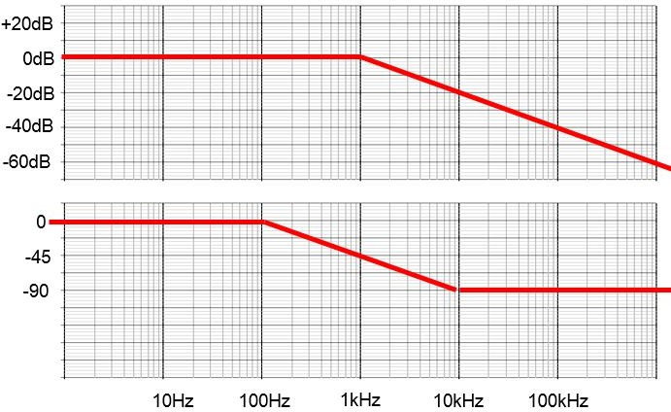
Bode-plot vs. Time domain
Assume: input voltage = sinewave with 1V amplitude and 100Hz frequency.
Output voltage = ?
0dB ➔ output amplitude is the same as input amplitude 0 degree ➔ output phase is the same as the input phase

Slide 42
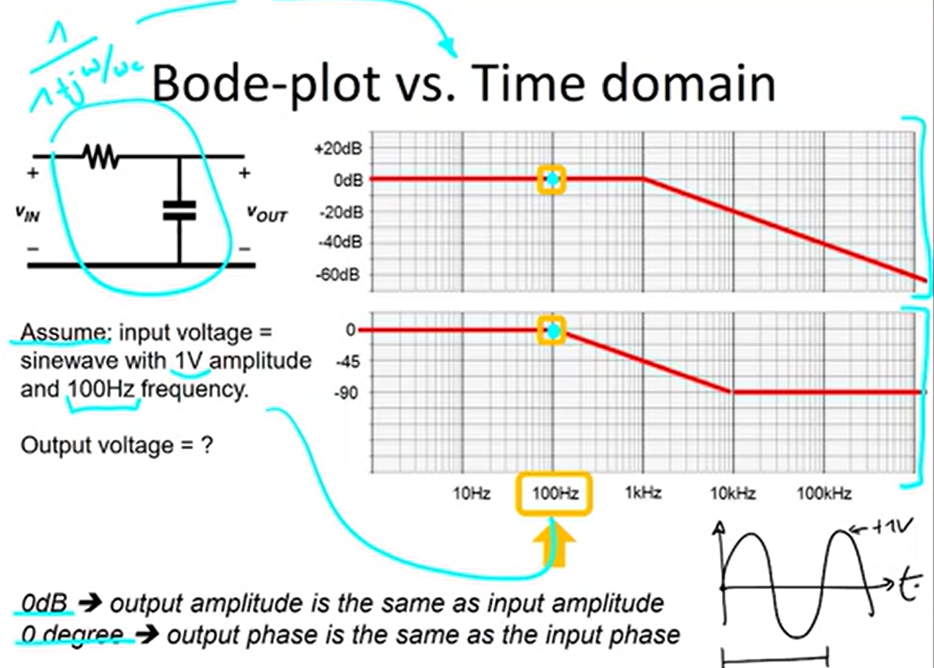

Slide 43
Bode-plot vs. Time domain
Assume: input voltage = sinewave with 1V amplitude and 1kHz frequency.
Output voltage = ?
-3dB ➔ output amplitude attenuated by 0.707 ➔ 0.707V amplitude
-45 degree ➔ output phase is -45 degrees compared to input phase

Slide 44
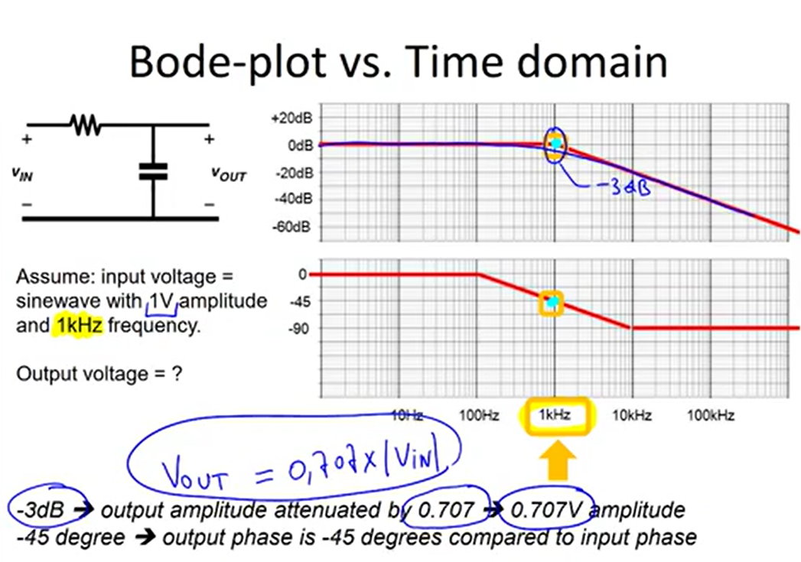

Slide 45
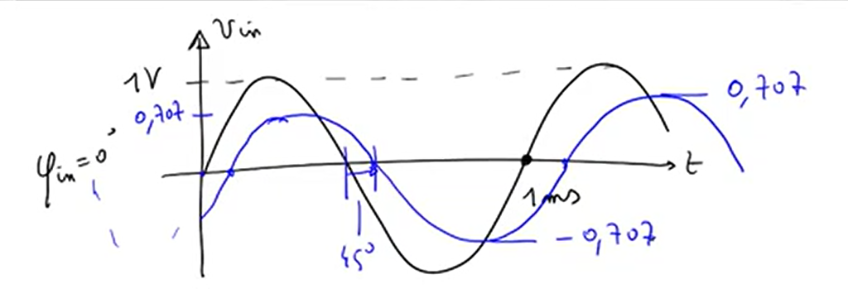

Slide 46
Bode-plot vs. Time domain
Assume: input voltage = sinewave with 1V amplitude and 10kHz frequency.
Output voltage = ?
-20dB ➔ output amplitude attenuated by 0.1 ➔ 0.1V amplitude
-90 degree ➔ output phase is -90 degrees compared to input phase

Slide 47
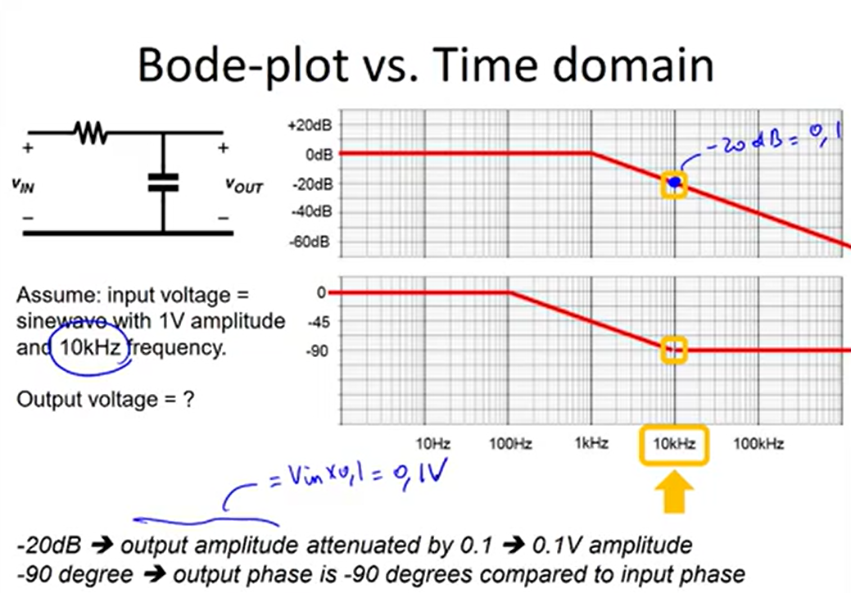

Slide 48
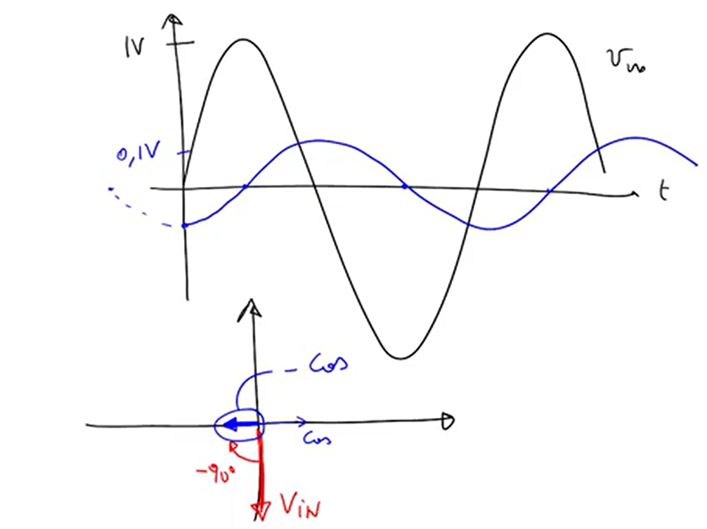

Slide 49

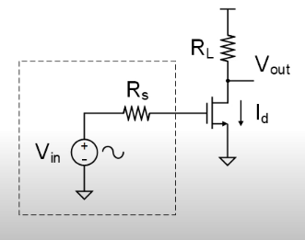
Common Source amplifier

Slide 50
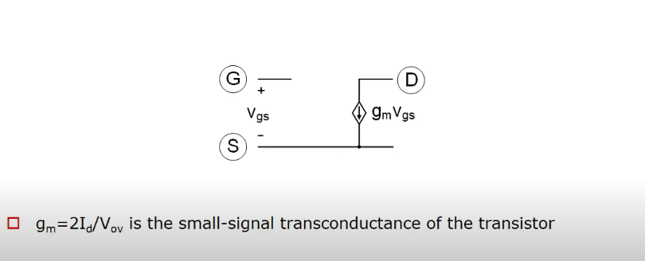
1st Order Small Signal Model (Active Region)

Slide 51
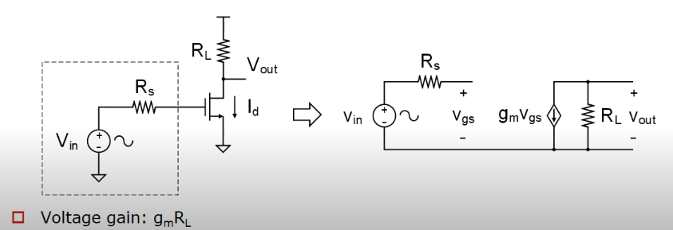
Common Source Amplifier

Slide 52

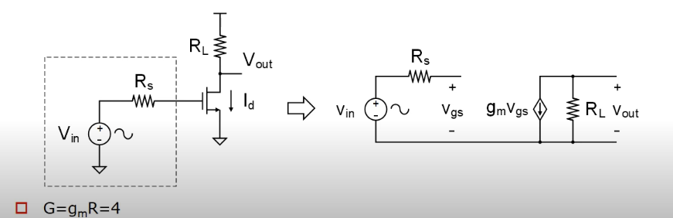

Slide 53
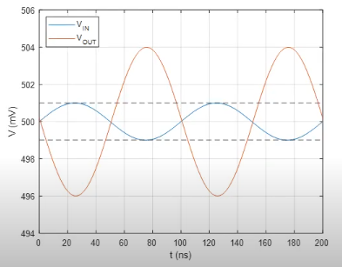
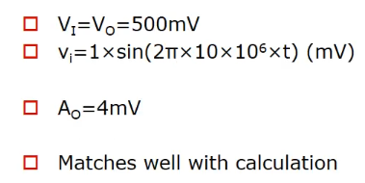

Slide 54
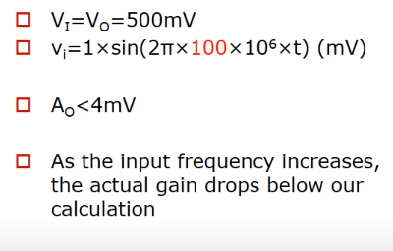
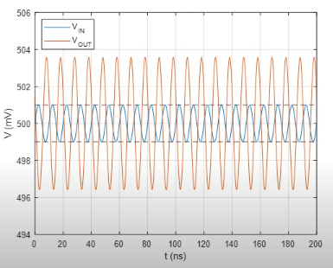

Slide 55
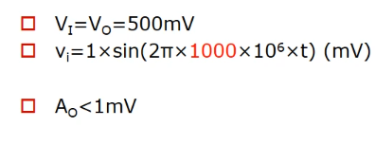


Slide 56



Slide 57


Transistor in Triode Region

Slide 58


Transistor in Active region

Slide 59


Transistor Off

Slide 60

Intrinsic MOS Capacitor summary

Slide 61


Common Source amplifier revisited

Slide 62

Frequency Response

Slide 63


Slide 64

Extrinsic Capacitance

Slide 65

Overlap Capacitance

Slide 66

MOS Capacitor Summary

Slide 67

Common Source amplifier revisited

Slide 68

Bandwidth Estimation

Slide 69

Millar Approximation

Slide 70

Modified Input Network

Slide 71

Improved Bandwidth estimate

Slide 72

Assumptions Check

Slide 73

Effect of output Loading (1)

Slide 74

Effect of output Loading (2)

Slide 75

Zero Time constant Analysis

Slide 76

Example (1)

Slide 77


Example (2)

Slide 78

Bandwidth estimation based on ZVCT

Slide 79


Inclusion of CL

Slide 80

How ZVTCs works

Slide 81
When we talk about analog and mixed-signal design, one invisible force keeps showing up everywhere—
feedback. It quietly controls gain, sets bias points, stabilizes oscillators, shapes filters, and even allows our amplifiers to work linearly. Without feedback, most of our circuits would either blow up in instability or behave unpredictably.”
Feedback is like the steering wheel in a car:
Without it, you go off-road.
With too much of it, you oversteer.
With the right balance, you drive smoothly

Slide 82
2. Types of Feedback
(a) Positive Feedback
Intuition: It’s like talking in a room with a microphone and a loudspeaker.
  Your voice enters the mic → amplified → fed back into the loudspeaker → mic again → louder and louder → instability (screeching sound).
In circuits:
  Positive feedback reinforces signals.
  Used in oscillators, comparators, regenerative circuits.
  But if left uncontrolled, it leads to instability.
(b) Negative Feedback
Intuition: Think of a thermostat in an air conditioner:
  If temperature rises, AC cools harder.
  If temperature drops, AC relaxes.
  Outcome: room stabilizes at a set point.
In circuits:
  Reduces gain variation.
  Improves linearity.
  Expands bandwidth.

Slide 83



Life without feedback
2. Life Without Feedback
Consider: A voltage amplifier with gain A₀.
It suffers from four major limitations:
Gain Variation with Environment
  Gain depends on supply voltage and temperature.
  Gain can vary by a factor of 1–2 over normal temperature ranges.
Frequency Dependence (Bandwidth Limitation)
  Gain decreases beyond a certain frequency.
  Usable only up to bandwidth f₀.
Finite Output Resistance
  Output gain depends on the load resistance.
  Heavier load → lower gain.
Nonlinearity
  For large signal swings, gain reduces.
  Leads to distortion and nonlinear response.
➡️ These four issues limit practical usability.

Slide 84





Life with feedback (1)

Slide 85




Life with feedback (2)
How Feedback Solves the Four Issues:
Gain Stability
  Even if A₀ varies with temperature, y/x remains ≈1.
  Output less sensitive to environmental changes.
Wider Bandwidth
  Gain from x → y remains near unity up to bandwidth ≈ A₀·f₀.
  Feedback extends effective bandwidth.
Lower Output Resistance
  Effective output resistance reduced by factor (1 + A₀).
  Less sensitive to load variations.
Improved Linearity
  Output remains a faithful copy of input even at higher swings.
  Nonlinearity suppressed

Slide 86





Why better than wire
Source follower
The issue is load does not need a constant current
And the SF have some out put resistance so it
creates a problem

Slide 87




From output to input

Slide 88


Slide 89


Slide 90



Virtual ground for high linearity

Slide 91


Virtual ground for high linearity

Slide 92

Virtual ground for wider bandwidth

